Slide 1
Chapter 2 Arrays and Structures

Slide 2
Chapter 2 Arrays and Structures
2.1 Arrays
2.2 Dynamically Allocated Arrays (option)
2.3 Structures and Unions
2.4 Polynomial
2.5 Sparse Matrices
2.6 Representation of Multidimensional Arrays
2.7 Strings

Slide 3
Arrays

Slide 4
The Abstract Data Type
2.1 The Abstract Data Type
The array as an ADT
Array: a set of pairs, <index, value>
data structure
For each index, there is a value associated with that index.
representation (possible)
Implemented by using consecutive memory.

Slide 5
The Abstract Data Type
When considering an ADT we are more concerned with the operations that can be performed on an array.
Aside from creating a new array, most languages provide only two standard operations for arrays, one that retrieves a value, and a second that stores a value.
What is the complexity of “retrieve” in an array?
Don’t have t0 search: O(1)
Do have to search: O(n)
What is the complexity of “store” in an array?
O(1)
What about insertion/deletion in an array?
O(n)

Slide 6
The Abstract Data Type
Structure Array is objects: A set of pairs <index, value> where for each value of index there is a value from the set item. Index is a finite ordered set of one or more dimensions, for example, {0, … , n-1} for one dimension, {(0,0),(0,1),(0,2),(1,0),(1,1),(1,2),(2,0),(2,1),(2,2)} for two dimensions, etc. Functions: for all A ∈ Array, i ∈ index, x ∈ item, j, size ∈ integer Array Create(j, list) ::= return an array of j dimensions where list is a j-tuple whose ith element is the size of the ith dimension. Items are undefined. Item Retrieve(A, i) ::= if (i ∈ index) return the item associated with index value i in array A else return error Array Store(A, i, x) ::= if (i in index) return an array that is identical to array A except the new pair <i, x> has been inserted else return error end array

Slide 7
Array in C
int list[5], *plist[5];
list[5]: five integers
list[0], list[1], list[2], list[3], list[4]
*plist[5]: five pointers to integers
plist[0], plist[1], plist[2], plist[3], plist[4]
implementation of 1-D array
list[0] base address = α
list[1] α + sizeof(int)
list[2] α + 2*sizeof(int)
list[3] α + 3*sizeof(int)
list[4] α + 4*size(int)

Slide 8
Array in C
Compare int *list1 and int list2[5] in C.
Same: list1 and list2 are pointers.
Difference: list2 reserves five locations.
Notations:
list2 - a pointer to list2[0]
(list2 + i) - a pointer to list2[i] (&list2[i])
*(list2 + i) - list2[i]

Slide 9
Array in C
int one[] = {0, 1, 2, 3, 4};
//Goal: print out address and value
void print1(int *ptr, int rows)
{
/* print out a one-dimensional array using a pointer */
int i;
printf("Address Contents\n");
for (i=0; i < rows; i++)
printf("%8u%5d\n", ptr+i, *(ptr+i));
printf("\n");
}

Slide 10
Array Address
1-dimension
1-dimension Array: A_{n}
Each item space: d
Initial address: L₀ => address(A[0]) = L₀
address(A[1]) = L₀ + d
address(A[2]) = L₀ + 2d
…
address(A[n-1]) = L₀ + (n-1)d

Slide 11
Array Address
2-dimension
2-dimension Array: A_{m,n}
Each item space: d
Initial address: L₀ => address(A[0,0]) = L₀
Row major
address(A[0,1]) = L₀ + d
address(A[0,2]) = L₀ + 2d
…
address(A[0,n-1]) = L₀ + (n-1)d
address(A[1,0]) = L₀ + nd
…
address(A[1,n-1]) = L₀ + nd +(n-1)d
address(A[i,j]) = L₀ + ind +jd
address(A[m-1,n-1]) = L₀ + (m-1)nd +(n-1)d
列優先, 每列處理完後才換下一列
1 | 2 | 3 | 4
5 | 6 | 7 | 8
9 | 10 | 11 | 12
A_{3,4}

Slide 12

Array Address
Row major
2-dimension Array: A_{m,n}
Each item space: d
A(m₁:m₂, n₁:n₂)
Initial address: L₀ => address(A[m₁, n₁]) = L₀
$A\left[i,j\right]=L_{o}+\left(i−m_{1}\right)nd+\left(j−n_{1}\right)d$

Slide 13
Array Address
2-dimension
2-dimension Array: A_{m,n}
Each item space: d
Initial address: L₀ => address(A[0,0]) = L₀
Column major
address(A[1,0]) = L₀ + d
address(A[2,0]) = L₀ + 2d
…
address(A[m-1,0]) = L₀ + (m-1)d
address(A[0,1]) = L₀ + md
…
address(A[m-1,1]) = L₀ + md +(m-1)d
address(A[i,j]) = L₀ + jmd +id
address(A[m-1,n-1]) = L₀ + (n-1)md +(m-1)d
行優先, 每行處理完後才換下一行
1 | 4 | 7 | 10
2 | 5 | 8 | 11
3 | 6 | 9 | 12
A_{3,4}

Slide 14

Array Address
Column major
2-dimension Array: A_{m,n}
Each item space: d
A(m₁:m₂, n₁:n₂)
Initial address: L₀ => address(A[m₁, n₁]) = L₀
$A\left[i,j\right]=L_{o}+\left(j−n_{1}\right)md+\left(i−m_{1}\right)d$

Slide 15


Example
address(A[3,2]) = 1110
address(A[2,3]) = 1115
item space d = 1
A[1, 4] = ?
A[5, 4] =?
Row – major
$$A\left[i,j\right]=L_{o}+\left(i−m_{1}\right)nd+\left(j−n_{1}\right)d$$
$$A\left[3, 2\right]=L_{o}+\left(3−m_{1}\right)n+\left(2−n_{1}\right)=1110$$
$$A\left[2, 3\right]=L_{o}+\left(2−m_{1}\right)n+\left(3−n_{1}\right)=1115$$
$$n=−4$$
Column – major
$$A\left[i,j\right]=L_{o}+\left(j−n_{1}\right)md+\left(i−m_{1}\right)d$$
$$A\left[3, 2\right]=L_{o}+\left(2−n_{1}\right)m+\left(3−m_{1}\right)=1110$$
$$A\left[2, 3\right]=L_{o}+\left(3−n_{1}\right)m+\left(2−m_{1}\right)=1115$$
$$m=6, n_{1}m+m_{1}=1095$$
$$A\left[1, 4\right]=L_{o}+\left(4−n_{1}\right)m+\left(1−m_{1}\right)=1120$$
$$A\left[5, 4\right]=L_{o}+\left(4−n_{1}\right)m+\left(5−m_{1}\right)=1124$$

Slide 16


Example
address(A[7,8]) = 2732
address(A[13,16]) = 3364
item space d = 4
A[9, 6] = ?
Row – major
$$A\left[i,j\right]=L_{o}+\left(i−m_{1}\right)nd+\left(j−n_{1}\right)d$$
$$A\left[7,8\right]=L_{o}+\left(7−m_{1}\right)n×4+\left(8−n_{1}\right)×4=2732$$
$$A\left[13, 16\right]=L_{o}+\left(13−m_{1}\right)n×4+\left(16−n_{1}\right)×4=3364$$
$$n=25, L_{o}−4m_{1}n−4n_{1}=2700−28n$$
$$A\left[9, 6\right]=L_{o}+\left(9−m_{1}\right)n×4+\left(6−n_{1}\right)×4=2924$$
Column – major
$$A\left[i,j\right]=L_{o}+\left(j−n_{1}\right)md+\left(i−m_{1}\right)d$$
$$A\left[7, 8\right]=L_{o}+\left(8−n_{1}\right)m×4+\left(7−m_{1}\right)×4=2732$$
$$A\left[13, 16\right]=L_{o}+\left(16−n_{1}\right)m×4+\left(13−m_{1}\right)×4=3364$$
$$m=19,L_{o}−4n_{1}m−4m_{1}=2672−32m$$
$$A\left[9,6\right]=L_{o}+\left(6−n_{1}\right)m×4+\left(9−m_{1}\right)×4=2592$$

Slide 17


Note
Row – major
$$A\left[i,j\right]=L_{o}+\left(i−m_{1}\right)nd+\left(j−n_{1}\right)d$$
$$\left\{\begin{aligned}A\left[i_{1},j_{1}\right]=L_{o}+\left(i_{1}−m_{1}\right)nd+\left(j_{1}−n_{1}\right)d=L_{1} \\ A\left[i_{2},j_{2}\right]=L_{o}+\left(i_{2}−m_{1}\right)nd+\left(j_{2}−n_{1}\right)d=L_{2}\end{aligned}\right.$$
$$\left\{\begin{aligned}L_{o}+\left(i_{1}−m_{1}\right)nd+\left(j_{1}−n_{1}\right)d=L_{1} \\ L_{o}+\left(i_{2}−m_{1}\right)nd+\left(j_{2}−n_{1}\right)d=L_{2}\end{aligned}\right.$$
$$\left(i_{2}−i_{1}\right)nd+\left(j_{2}−j_{1}\right)d=L_{2}−L_{1}$$
address(A[i₁,j₁]) = L₁
address(A[i₂,j₂]) = L₂
item space d
A[i,j] = ?
Column – major
$$A\left[i,j\right]=L_{o}+\left(j−n_{1}\right)md+\left(i−m_{1}\right)d$$
$$\left\{\begin{aligned}A\left[i_{1},j_{1}\right]=L_{o}+\left(j_{1}−n_{1}\right)md+\left(i_{1}−m_{1}\right)d=L_{1} \\ A\left[i_{2},j_{2}\right]=L_{o}+\left(j_{2}−n_{1}\right)md+\left(i_{2}−m_{1}\right)d=L_{2}\end{aligned}\right.$$
$$\left\{\begin{aligned}L_{o}+\left(j_{1}−n_{1}\right)md+\left(i_{1}−m_{1}\right)d=L_{1} \\ L_{o}+\left(j_{2}−n_{1}\right)md+\left(i_{2}−m_{1}\right)d=L_{2}\end{aligned}\right.$$
$$\left(j_{2}−j_{1}\right)md+\left(i_{2}−i_{1}\right)d=L_{2}−L_{1}$$

Slide 18

Example
address(A[7,8]) = 2732
address(A[13,16]) = 3364
item space d = 4
A[9, 6] = L
Row – major
$$A\left[i,j\right]=L_{o}+\left(i−m_{1}\right)nd+\left(j−n_{1}\right)d$$
$$\left\{\begin{aligned}A\left[i_{1},j_{1}\right]=L_{o}+\left(i_{1}−m_{1}\right)nd+\left(j_{1}−n_{1}\right)d=L_{1} \\ A\left[i_{2},j_{2}\right]=L_{o}+\left(i_{2}−m_{1}\right)nd+\left(j_{2}−n_{1}\right)d=L_{2}\end{aligned}\right.$$
$$\left\{\begin{aligned}L_{o}+\left(i_{1}−m_{1}\right)nd+\left(j_{1}−n_{1}\right)d=L_{1} \\ L_{o}+\left(i_{2}−m_{1}\right)nd+\left(j_{2}−n_{1}\right)d=L_{2}\end{aligned}\right.$$
$$\left(i_{2}−i_{1}\right)nd+\left(j_{2}−j_{1}\right)d=L_{2}−L_{1}$$
$\left(13−7\right)n×4+(16−8)$ $×4=3364−2732$
$$n=25$$
$\left(9−7\right)n×4+(6−8)$ $×4=L−2732$
$$L=2924$$

Slide 19

Example
Column – major
$$A\left[i,j\right]=L_{o}+\left(j−n_{1}\right)md+\left(i−m_{1}\right)d$$
$$\left\{\begin{aligned}A\left[i_{1},j_{1}\right]=L_{o}+\left(j_{1}−n_{1}\right)md+\left(i_{1}−m_{1}\right)d=L_{1} \\ A\left[i_{2},j_{2}\right]=L_{o}+\left(j_{2}−n_{1}\right)md+\left(i_{2}−m_{1}\right)d=L_{2}\end{aligned}\right.$$
$$\left\{\begin{aligned}L_{o}+\left(j_{1}−n_{1}\right)md+\left(i_{1}−m_{1}\right)d=L_{1} \\ L_{o}+\left(j_{2}−n_{1}\right)md+\left(i_{2}−m_{1}\right)d=L_{2}\end{aligned}\right.$$
$$\left(j_{2}−j_{1}\right)md+\left(i_{2}−i_{1}\right)d=L_{2}−L_{1}$$
$\left(16−8\right)m×4+(13−7)$ $×4=3364−2732$
$$m=19$$
$\left(6−8\right)m×4+(9−7)$ $×4=L−2732$
$$L=2592$$
address(A[7,8]) = 2732
address(A[13,16]) = 3364
item space d = 4
A[9, 6] = L

Slide 20
Structures and Unions

Slide 21
Structures and Unions
2.3.1 Structures (Records)
Arrays are collections of data of the same type. In C there is an alternate way of grouping data that permit the data to vary in type.
This mechanism is called the struct, short for structure.
A structure is a collection of data items, where each item is identified as to its type and name.
struct {
char name[10];
int age;
float salary;
} person;
strcpy(person.name, "james");
person.age=10;
person.salary=35000;

Slide 22
Structures and Unions
Create structure data type
We can create our own structure data types by using the typedef statement as below:
This says that human_being is the name of the type defined by the structure definition, and we may follow this definition with declarations of variables such as:
human_being person1, person2;
typedef struct human_being {
char name[10];
int age;
float salary;
};
typedef struct {
char name[10];
int age;
float salary
} human_being;

Slide 23
Structures and Unions
We can also embed a structure within a structure.
typedef struct {
int month;
int day;
int year;
} date;
typedef struct human_being {
char name[10];
int age;
float salary;
date dob;
};

Slide 24
Structures and Unions
E.g : A person born on February 11, 1994, would have values for the date struct set as
human_being person1, person2;
person1.dob.month = 2;
person1.dob.day = 11;
person1.dob.year = 1944;

Slide 25
Structures and Unions
2.3.2 Unions
A union declaration is similar to a structure.
The fields of a union must share their memory space.
Only one field of the union is “active” at any given time
typedef struct sex_type {
enum tag_field {female, male} sex;
union {
int children;
int beard;
} u;
};
typedef struct human_being {
char name[10];
int age;
float salary;
date dob;
sex_type sex_info;
}
human_being person1, person2;
person1.sex_info.sex = male;
person1.sex_info.u.beard = FALSE;
person2.sex_info.sex = female;
person2.sex_info.u.children = 4;
Memory Layout
sex_type
enum tag_field
u
int children
int beard

Slide 26
Structures and Unions
2.3.3 Internal implementation of structures
The fields of a structure in memory will be stored in the same way using increasing address locations in the order specified in the structure definition.
Holes or padding may actually occur
Within a structure to permit two consecutive components to be properly aligned within memory
The size of an object of a struct or union type is the amount of storage necessary to represent the largest component, including any padding that may be required.

Slide 27
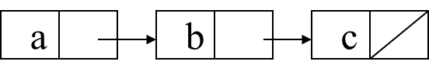
Structures and Unions
2.3.4 Self-Referential Structures
One or more of its components is a pointer to itself.
typedef struct list {
char data;
list *link;
}
list item1, item2, item3;
item1.data='a';
item2.data='b';
item3.data='c';
item1.link=item2.link=item3.link=NULL;
Construct a list with three nodes
item1.link=&item2;
item2.link=&item3;
malloc: obtain a node
free: release memory

Slide 28
Polynomial

Slide 29
Polynomial
2.4.1 The polynomial ADT
We can use array to implement other ADT, for example: Ordered or Linear List
Ordered (linear) list: (item₁, item₂, item₃, …, item_{n})
(Sunday, Monday, Tuesday, Wednesday, Thursday, Friday, Saturday)
(Ace, 2, 3, 4, 5, 6, 7, 8, 9, 10, Jack, Queen, King)
(1941, 1942, 1943, 1944, 1945)
(a1, a2, a3, …, an-1, an)

Slide 30
Polynomial
Operations on Ordered List
1. Finding the length, n , of the list.
2. Reading the items from left to right (or right to left).
3. Retrieving the i’th element.
4. Storing a new value into the i’th position.
5. Inserting a new element at the position i , causing elements numbered i, i+1, …, n to become numbered i+1, i+2, …, n+1
6. Deleting the element at position i , causing elements numbered i+1, …, n to become numbered i, i+1, …, n-1
Implementation
sequential mapping: represent an ordered list as an array where we associate the list item, item_{i}, with the index i.
1.~4. : sequential mapping
5.~6. : non-sequential mapping

Slide 31
Polynomial
Polynomial examples:
Two example polynomials are:
A(x) = 3x²⁰+2x⁵+4 and B(x) = x⁴+10x³+3x²+1
Assume that we have two polynomials, A(x) = Σa_{i}x^{i} and B(x) = Σb_{i}x^{i} where x is the variable, a_{i} is the coefficient, and i is the exponent, then:
A(x) + B(x) = Σ(a_{i} + b_{i})x^{i}
A(x) · B(x) = Σ(a_{i}x^{i} · Σ(b_{j}x^{j}))
Similarly, we can define subtraction and division on polynomials, as well as many other operations.

Slide 32
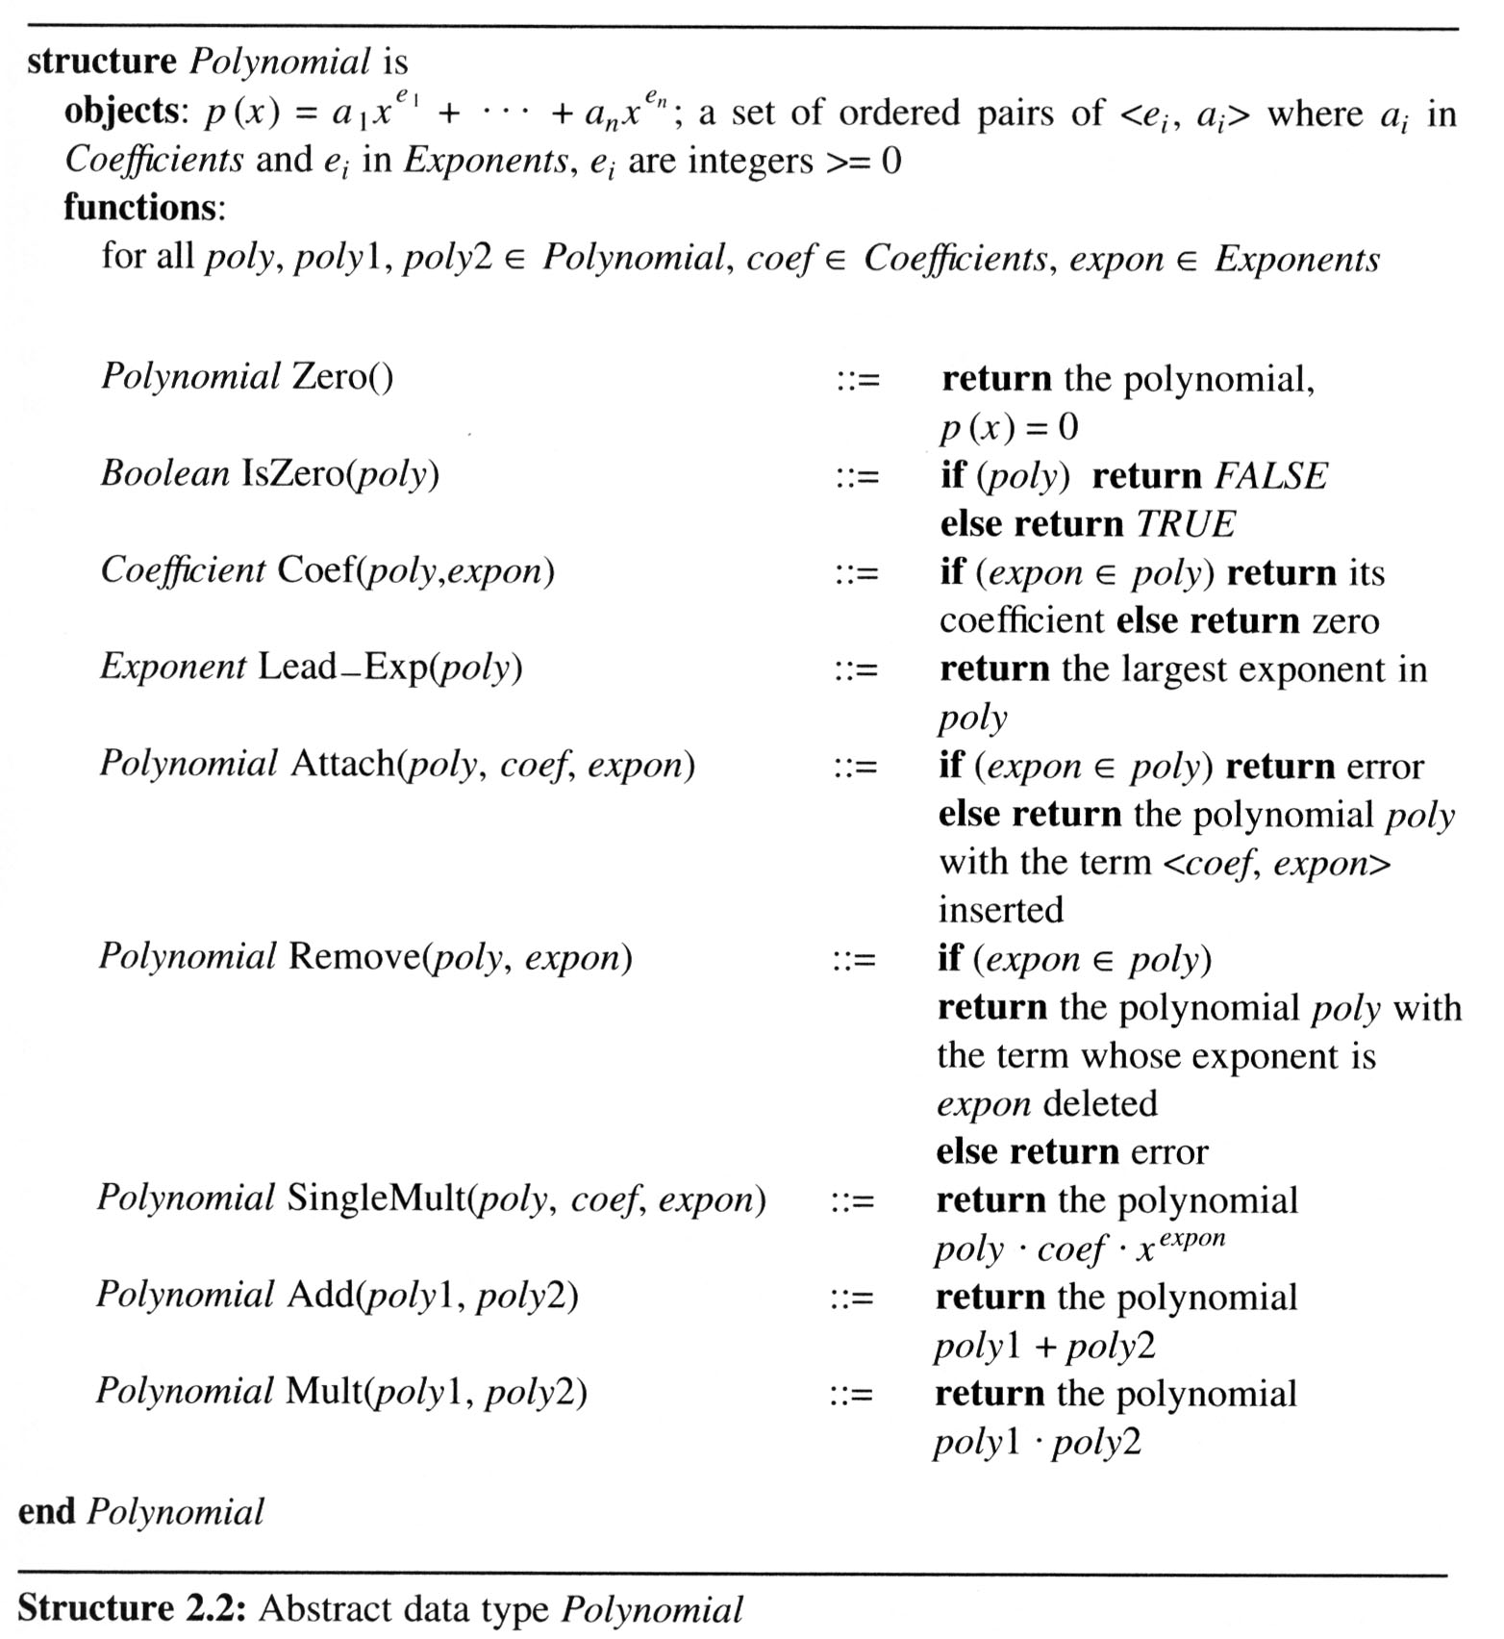
Polynomial
a : 係數
e: 次方
0 多項式
An ADT definition of a polynomial
判斷多項式是否為0多項式
回傳expon次方項的係數
回傳多項式最大次方
回傳插入<coef, expon>項後的多項式
回傳刪除次方expon項的多項式
多項式乘上expon次方項

Slide 33
Polynomial Addition
/* d =a + b, where a, b, and d are polynomials */
d = Zero( )
while (! IsZero(a) && ! IsZero(b)) do {
switch ( COMPARE (Lead_Exp(a), Lead_Exp(b) ){
case -1:
Attach(d, Coef (b, Lead_Exp(b)), Lead_Exp(b));
b = Remove(b, Lead_Exp(b));
break;
case 0:
sum = Coef (a, Lead_Exp (a)) + Coef ( b, Lead_Exp(b));
if (sum) {
Attach(d, sum, Lead_Exp(a));}
a = Remove(a , Lead_Exp(a));
b = Remove(b , Lead_Exp(b));
break;
case 1:
Attach(d, Coef (a, Lead_Exp(a)), Lead_Exp(a));
a = Remove(a, Lead_Exp(a));
}
}
a多項式最大次方 < b, d 插入b最高次方項, 移除b最高次方項
a多項式最大次方 = b, d 插入a最高次方項, 係數為相加, 移除a,b最高次方項
a多項式最大次方 > b, d 插入a最高次方項, 移除a最高次方項
advantage: easy implementation
disadvantage: waste space when sparse

Slide 34
/* d =a + b, where a, b, and d are polynomials */
d = Zero( )
while (! IsZero(a) && ! IsZero(b)) do {
switch ( COMPARE (Lead_Exp(a), Lead_Exp(b) ){
case -1:
Attach(d, Coef (b, Lead_Exp(b)), Lead_Exp(b));
b = Remove(b, Lead_Exp(b));
break;
case 0:
sum = Coef (a, Lead_Exp (a)) + Coef ( b, Lead_Exp(b));
if (sum) {
Attach (d, sum, Lead_Exp(a)); }
a = Remove(a , Lead_Exp(a));
b = Remove(b , Lead_Exp(b));
break;
case 1:
d = Attach(d, Coef (a, Lead_Exp(a)), Lead_Exp(a));
a = Remove(a, Lead_Exp(a));
}
}
EX: A(x) = 3x²⁰+2x⁵+4 and B(x) = x⁴+10x³+3x²+1
D(x) = A(x) + B(x)
A(x) = 3x²⁰+2x⁵+4
B(x) = x⁴+10x³+3x²+1
A(x) != ZERO B(x) != ZERO
A(x) = 3x²⁰+2x⁵+4
B(x) = x⁴+10x³+3x²+1
Lead_Exp(a) = 20 > Lead_Exp(b) = 4
A(x) = 3x²⁰+2x⁵+4
B(x) = x⁴+10x³+3x²+1
D(x) = 3x²⁰
A(x) = 2x⁵+4
B(x) = x⁴+10x³+3x²+1
D(x) = 3x²⁰
A(x) = 2x⁵+4
B(x) = x⁴+10x³+3x²+1
A(x) != ZERO B(x) != ZERO
A(x) = 2x⁵+4
B(x) = x⁴+10x³+3x²+1
Lead_Exp(a) = 5 > Lead_Exp(b) = 4
A(x) = 2x⁵+4
B(x) = x⁴+10x³+3x²+1
D(x) = 3x²⁰ ⁺ 2x⁵
A(x) = 4
B(x) = x⁴+10x³+3x²+1
D(x) = 3x²⁰ ⁺ 2x⁵
A(x) = 4
B(x) = x⁴+10x³+3x²+1
A(x) != ZERO B(x) != ZERO
A(x) = 4
B(x) = x⁴+10x³+3x²+1
Lead_Exp(a) = 0 < Lead_Exp(b) != 4
A(x) = 4
B(x) = x⁴+10x³+3x²+1
D(x) = 3x²⁰+2x⁵ ⁺ x⁴
A(x) = 4
B(x) = 10x³+3x²+1
D(x) = 3x²⁰+2x⁵ ⁺ x⁴
A(x) = 4
B(x) = 10x³+3x²+1
A(x) != ZERO B(x) != ZERO
A(x) = 4
B(x) = 10x³+3x²+1
Lead_Exp(a) = 0 < Lead_Exp(b) = 3
A(x) = 4
B(x) = 10x³+3x²+1
D(x) = 3x²⁰+2x⁵ + x⁴+10x³
A(x) = 4
B(x) = 3x²+1
D(x) = 3x²⁰+2x⁵ + x⁴+10x³
A(x) = 4
B(x) = 3x²+1
A(x) != ZERO B(x) != ZERO
A(x) = 4
B(x) = 3x²+1
Lead_Exp(a) = 0 < Lead_Exp(b) = 2
A(x) = 4
B(x) = 3x²+1
D(x) = 3x²⁰+2x⁵ +x⁴+10x³+3x²
A(x) = 4
B(x) = 1
D(x) = 3x²⁰+2x⁵ +x⁴+10x³+3x²
A(x) = 4
B(x) = 1
A(x) != ZERO B(x) != ZERO
A(x) = 4
B(x) = 1
Lead_Exp(a) = 0 == Lead_Exp(b) = 0
A(x) = 4
B(x) = 1
Sum(x) = A(x) + B(x) = 4 + 1 = 5
A(x) = 4
B(x) = 1
D(x) = 3x²⁰+2x⁵+x⁴+10x³+3x²+5
A(x) = ZERO
B(x) = ZERO
D(x) = 3x²⁰+2x⁵+x⁴+10x³+3x²+5
A(x) = ZERO
B(x) = ZERO

Slide 35
Polynomial
There are two ways to create the type polynomial in C
Representation I
#define MAX_degree 101
/*MAX degree of polynomial+1*/
typedef struct{
int degree;
float coef [MAX_degree];
} polynomial;
Drawback: The first
representation may
waste space.

Slide 36
Polynomial
specification representation
poly <start, finish>
A <0,1>
B <2,5>
Representation II
#define MAX_TERMS 100
/*size of terms array*/
typedef struct{
float coef;
int expon;
} polynomial;
polynomial terms [MAX_TERMS];
int avail = 0;
storage requirements: start, finish, 2*(finish-start+1)
A(x) = 2x¹⁰⁰⁰+1
B(x) = x⁴+10x³+3x²+1
 | startA | finishA | startB |  |  | finishB | avail
 | ↓ | ↓ | ↓ |  |  | ↓ | ↓
coef | 2 | 1 | 1 | 10 | 3 | 1
exp | 1000 | 0 | 4 | 3 | 2 | 0
 | 0 | 1 | 2 | 3 | 4 | 5 | 6
A
B

Slide 37
Polynomial
void padd (int starta, int finisha, int startb, int finishb, int * startd, int *finishd)
{/* add A(x) and B(x) to obtain D(x) */
float coefficient;
*startd = avail;
while (starta <= finisha && startb <= finishb) {
switch (COMPARE(terms[starta].expon,terms[startb].expon)) {
case -1: /* a expon < b expon */
attach(terms[startb].coef, terms[startb].expon);
startb++;
break;
case 0: /* equal exponents */
coefficient = terms[starta].coef +terms[startb].coef;
if (coefficient) attach (coefficient, terms[starta].expon);
starta++;
startb++;
break;
case 1: /* a expon > b expon */
attach(terms[starta].coef, terms[starta].expon);
starta++;
}
}
/* add in remaining terms of A(x) */
for( ; starta <= finisha; starta++)
attach(terms[starta].coef, terms[starta].expon);
/* add in remaining terms of B(x) */
for( ; startb <= finishb; startb++)
attach(terms[startb].coef, terms[startb].expon);
*finishd =avail -1;
}
A function that adds two polynomials, A and B, represented as above to obtain D = A + B.
To produce D(x), padd adds A(x) and B(x) term by term.
a多項式最大次方 < b, d 插入b最高次方項, b移到下一項
a多項式最大次方 = b, d 插入a最高次方項, 係數為相加 a,b 移到下一項
a多項式最大次方 > b, d 插入a最高次方項, a移到下一項
補上後續剩餘的項目
Analysis: O(n+m)
where n is the number of nonzeros in A, and m is the number of nonzeros in B

Slide 38
void padd (int starta, int finisha, int startb, int finishb, int * startd, int *finishd)
{/* add A(x) and B(x) to obtain D(x) */
float coefficient;
*startd = avail;
while (starta <= finisha && startb <= finishb) {
switch (COMPARE(terms[starta].expon,terms[startb].expon)) {
case -1: /* a expon < b expon */
attach(terms[startb].coef, terms[startb].expon);
startb++;
break;
case 0: /* equal exponents */
coefficient = terms[starta].coef +terms[startb].coef;
if (coefficient) attach (coefficient, terms[starta].expon);
starta++;
startb++;
break;
case 1: /* a expon > b expon */
attach(terms[starta].coef, terms[starta].expon);
starta++;
}
}
/* add in remaining terms of A(x) */
for( ; starta <= finisha; starta++)
attach(terms[starta].coef, terms[starta].expon);
/* add in remaining terms of B(x) */
for( ; startb <= finishb; startb++)
attach(terms[startb].coef, terms[startb].expon);
*finishd =avail -1;
}

Slide 39
void padd (int starta, int finisha, int startb, int finishb, int * startd, int *finishd)
{/* add A(x) and B(x) to obtain D(x) */
float coefficient;
*startd = avail;
while (starta <= finisha && startb <= finishb) {
switch (COMPARE(terms[starta].expon,terms[startb].expon)) {
case -1: /* a expon < b expon */
attach(terms[startb].coef, terms[startb].expon);
startb++;
break;
case 0: /* equal exponents */
coefficient = terms[starta].coef +terms[startb].coef;
if (coefficient) attach (coefficient, terms[starta].expon);
starta++;
startb++;
break;
case 1: /* a expon > b expon */
attach(terms[starta].coef, terms[starta].expon);
starta++;
}
}
/* add in remaining terms of A(x) */
for( ; starta <= finisha; starta++)
attach(terms[starta].coef, terms[starta].expon);
/* add in remaining terms of B(x) */
for( ; startb <= finishb; startb++)
attach(terms[startb].coef, terms[startb].expon);
*finishd =avail -1;
}
A(x) = 2x¹⁰⁰⁰+1
B(x) = x⁴+10x³+3x²+1
starta = 0 finisha = 1
startb = 2 finishb = 5
starta <= finisha = TRUE
startb <= finishb = TRUE
A(x) = 2x¹⁰⁰⁰+1
B(x) = x⁴+10x³+3x²+1
term[starta].expon = 1000 > term[startb].expon = 4
A(x) = 2x¹⁰⁰⁰+1
B(x) = x⁴+10x³+3x²+1
starta ++ ;
starta = 1;
A(x) = 2x¹⁰⁰⁰+1
B(x) = x⁴+10x³+3x²+1
starta = 1 finisha = 1
startb = 2 finishb = 5
starta <= finisha = TRUE
startb <= finishb = TRUE
A(x) = 2x¹⁰⁰⁰+1
B(x) = x⁴+10x³+3x²+1
term[starta].expon = 0 > term[startb]. expon = 4
A(x) = 2x¹⁰⁰⁰+1
B(x) = x⁴+10x³+3x²+1
startb++ ;
startb = 3;
A(x) = 2x¹⁰⁰⁰+1
B(x) = x⁴+10x³+3x²+1
starta = 1 finisha = 1
startb = 3 finishb = 5
starta <= finisha = TRUE
startb <= finishb = TRUE
A(x) = 2x¹⁰⁰⁰+1
B(x) = x⁴+10x³+3x²+1
term[starta].expon = 0 < term[startb]. expon = 3
A(x) = 2x¹⁰⁰⁰+1
B(x) = x⁴+10x³+3x²+1
startb++ ;
startb = 4;
A(x) = 2x¹⁰⁰⁰+1
B(x) = x⁴+10x³+3x²+1
starta = 1 finisha = 1
startb = 4 finishb = 5
starta <= finisha = TRUE
startb <= finishb = TRUE
A(x) = 2x¹⁰⁰⁰+1
B(x) = x⁴+10x³+3x²+1
term[starta].expon = 0 < term[startb]. expon = 2
A(x) = 2x¹⁰⁰⁰+1
B(x) = x⁴+10x³+3x²+1
startb++ ;
startb = 5;
A(x) = 2x¹⁰⁰⁰+1
B(x) = x⁴+10x³+3x²+1
starta = 1 finisha = 1
startb = 5 finishb = 5
starta <= finisha = TRUE
startb <= finishb = TRUE
A(x) = 2x¹⁰⁰⁰+1
B(x) = x⁴+10x³+3x²+1
term[starta].expon = 0 == term[startb]. expon = 0
coeffieicent =
term[starta] + term [startb] =
2
A(x) = 2x¹⁰⁰⁰+1
B(x) = x⁴+10x³+3x²+1
starta ++ ;
startb++ ;
starta = 2;
startb = 6;
A(x) = 2x¹⁰⁰⁰+1
B(x) = x⁴+10x³+3x²+1
starta = 2 finisha = 1
startb = 6 finishb = 5
starta <= finisha = FALSE
startb <= finishb = FALSE
Term
2x¹⁰⁰⁰
1
x⁴
10x³
3x²
1
2x¹⁰⁰⁰
x⁴
10x³
10x²
2

Slide 40
polynomial
void attach(float coefficient, int exponent)
{ /* add a new term to the polynomial */
if (avail >= MAX_TERMS) {
fprintf(stderr, "Too many terms in the polynomial\n");
exit(1);
}
terms[avail].coef = coefficient;
terms[avail++].expon = exponent;
}
Problem: Compaction is required
when polynomials that are no longer needed.
(data movement takes time.)

Slide 41
Sparse Matrices

Slide 42

Sparse Matrices
2.5.1 Introduction
In mathematics, a matrix contains m rows and n columns of elements, we write m×n to designate a matrix with m rows and n columns.
$$\left[\begin{matrix}−27 & 3 & 4 \\ 6 & 82 & −2 \\ \begin{aligned}109 \\ 12 \\ 48\end{aligned} & \begin{aligned}−64 \\ 8 \\ 27\end{aligned} & \begin{aligned}11 \\ 9 \\ 47\end{aligned}\end{matrix}\right]$$
5 x 3
15/15
6 x 6
8/36
sparse matrix
data structure?

Slide 43
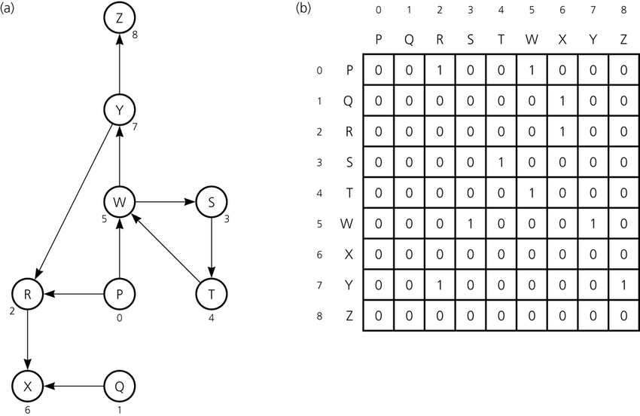
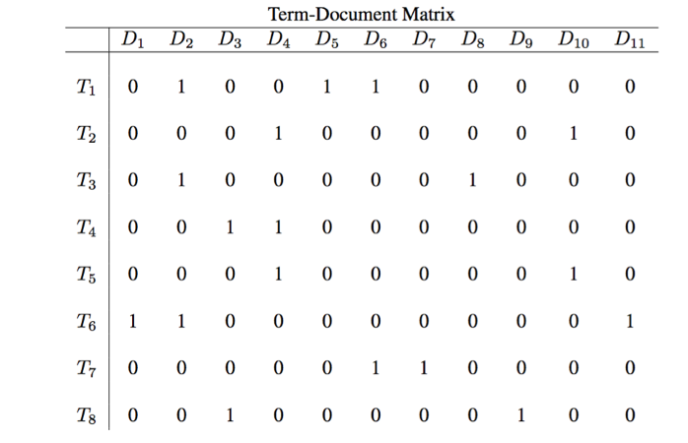
Example
Term-document matrix
adjacency matrix
https://www.chegg.com/homework-help/questions-and-answers/term-document-matrix-di-d2-d3-d4-d5-d6-d7-ds-dg-dio-d1-0-1-0-0-1-1-0-0-0-0-t2-00-0-1-0-0-0-q28620105
https://www.researchgate.net/figure/a-A-directed-graph-and-b-its-adjacency-matrix_fig2_239491573

Slide 44
Sparse Matrices
The standard representation of a matrix is a two dimensional array defined as
a[MAX_ROWS][MAX_COLS]
We can locate quickly any element by writing a[i ][ j ]
Sparse matrix wastes space
We must consider alternate forms of representation.
Our representation of sparse matrices should store only nonzero elements.
Each element is characterized by <row, col, value>.

Slide 45
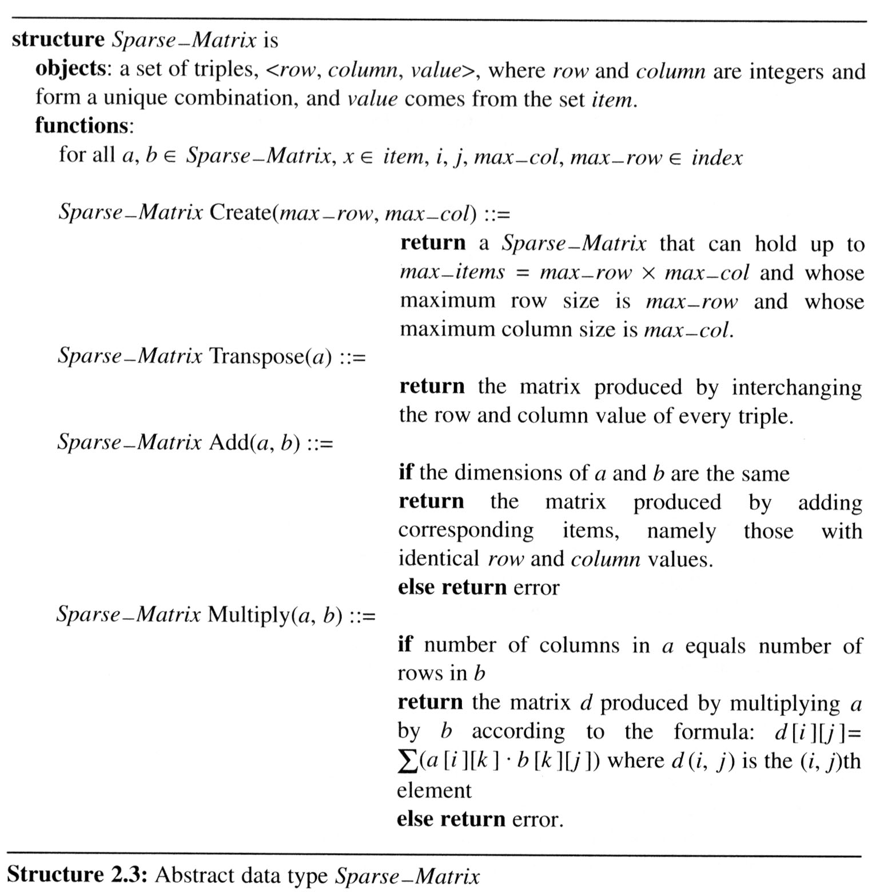
Sparse Matrices
A minimal set of operations
Matrix creation
Transpose
Addition
Multiplication

Slide 46
Sparse Matrices
Create operation
Sparse_matrix Create(max_row, max_col) ::=
#define MAX_TERMS 101 /* maximum number of terms +1*/
typedef struct {
int col;
int row;
int value;
} term;
term a[MAX_TERMS];
第一筆紀錄
# of rows (columns)
# of nonzero terms

Slide 47
Sparse Matrices
Example
Represented by a two-dimensional array.
Each element is characterized by <row, col, value>.
row col value row col value a[0] 6 6 8 b[0] 6 6 8 [1] 0 0 15 [1] 0 0 15 [2] 0 3 22 [2] 0 4 91 [3] 0 5 -15 [3] 1 1 11 [4] 1 1 11 [4] 2 1 3 [5] 1 2 3 [5] 2 5 28 [6] 2 3 -6 [6] 3 0 22 [7] 4 0 91 [7] 3 2 -6 [8] 5 2 28 [8] 5 0 -15
# of columns
# of rows
# of nonzero terms
transpose
row, column in ascending order

Slide 48
Sparse Matrices
2.5.2 Transpose a Matrix
For each row i
take element <i, j, value> and store it in element <j, i, value> of the transpose.
difficulty: where to put <j, i, value> (0, 0, 15) ====> (0, 0, 15) (0, 3, 22) ====> (3, 0, 22) (0, 5, -15) ====> (5, 0, -15) (1, 1, 11) ====> (1, 1, 11) Move elements down very often.
For all elements in column j,
place element <i, j, value> in element <j, i, value>
以i來執行 => 不知新位置在哪 (按row排序)
以j來執行 => transpose後變row (可按row排序)

Slide 49
void transpose (term a[], term b[])
/* b is set to the transpose of a */
{
int n, i, j, currentb;
n = a[0].value; /* total number of elements */
b[0].row = a[0].col; /* rows in b = columns in a */
b[0].col = a[0].row; /*columns in b = rows in a */
b[0].value = n;
if (n > 0) { /*non zero matrix */
currentb = 1;
for (i = 0; i < a[0].col; i++)
/* transpose by columns in a */
for( j = 1; j <= n; j++)
/* find elements from the current column */
if (a[j].col == i) {
/* element is in current column, add it to b */
b[currentb].row = a[j].col;
b[currentb].col = a[j].row;
b[currentb].value = a[j].value;
currentb++;
}
}
}
For all columns i
For all elements in column j
Assign
A[i][j] to B[j][i]
place element <i, j, value> in element <j, i, value>
Scan the array “columns” times.
The array has “elements” elements.
==> O(columns*elements)

Slide 50
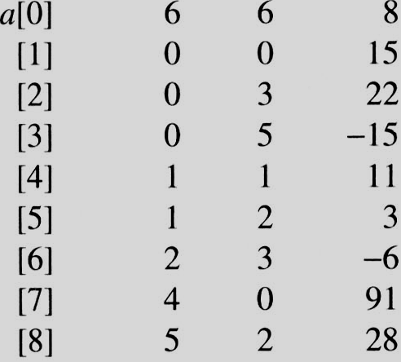
i=0 j=1
i=0 j=1
a[j]= 0 == i
i=0 j=2
i=0 j=2
a[j]=3 != i
i=0 j=3
i=0 j=3
a[j] = 5 != i
i=0 j=4
i=0 j=4
a[j].col = 1 a[j].col != i
i=0 j=5
i=0 j=5
a[j].col = 2 a[j].col != i
i=0 j=6
i=0 j=6
a[j].col = 3 != i
i=0 j=7
i=0 j=7
a[j].col = 0 == i
i=0 j=8
i=0 j=8
a[j].col = 2 != i
i=1 j=1
i=1 j=1
a[j].col = 0 != i
i=1 j=2
i=1 j=2
a[j].col = 3 != i
i=1 j=3
i=1 j=3
a[j].col = 5 != i
i=1 j=4
i=1 j=4
a[j].col = 1 == i
i=1 j=5
i=1 j=5
a[i].col = 2 != i
i=1 j=6
i=1 j=6
a[j].col = 3 != i
i=1 j=7
i=1 j=7
a[j] = 0 != i
i=1 j=8
EX: A[6][6] transpose to B[6][6]
i=1 j=8
a[i].col = 2 != i
Matrix A
Row Col Value
void transpose (term a[], term b[])
/* b is set to the transpose of a */
{
int n, i, j, currentb;
n = a[0].value; /* total number of elements */
b[0].row = a[0].col; /* rows in b = columns in a */
b[0].col = a[0].row; /*columns in b = rows in a */
b[0].value = n;
if (n > 0) { /*non zero matrix */
currentb = 1;
for (i = 0; i < a[0].col; i++)
/* transpose by columns in a */
for( j = 1; j <= n; j++)
/* find elements from the current column */
if (a[j].col == i) {
/* element is in current column, add it to b */
b[currentb].row = a[j].col;
b[currentb].col = a[j].row;
b[currentb].value = a[j].value;
currentb++;
}
}
}
Set Up row & column in B[6][6]
Row Col Value
0 6 6 8
1 0 0 15
2 0 4 91
3 1 1 11
And So on…

Slide 51
Sparse Matrices
Discussion: compared with 2-D array representation
O(columns*elements) vs. O(columns*rows)
elements --> columns * rows when non-sparse, O(columns²*rows)
Problem: Scan the array “columns” times.
In fact, we can transpose a matrix represented as a sequence of triples in O(columns + elements) time.
Solution:
First, determine the number of elements in each column of the original matrix.
Second, determine the starting positions of each row in the transpose matrix.
先掃一遍, 紀錄每行有幾個元素
=> 可先計算轉置後的位置

Slide 52
Sparse Matrices
void fastTranspose(term a[ ], term b[ ])
{/* the transpose of a is placed in b */
int rowTerms[MAX_COL], startingPos[MAX_COL];
int i, j, numCols = a[0].col, numTerms = a[0].value;
b[0].row = numCols;
b[0].col = a[0].row;
b[0].value = numTerms;
if (numTerms > 0){ /*nonzero matrix*/
for (i = 0; i < numCols; i++)
rowTerms[i] = 0;
for (i = 1; i <= numTerms; i++)
rowTerms[a[i].col]++;
startingPos[0] = 1;
for (i =1; i < numCols; i++)
startingPos[i]=startingPos[i-1] +rowTerms [i-1];
for (i=1; i <= numTerms, i++) {
j = startingPos[a[i].col]++;
b[j].row = a[i].col;
b[j].col = a[i].row;
b[j].value = a[i].value;
}
}
}
columns
先掃一遍, 紀錄每行有幾個元素
elements
計算每列開始位置
columns
elements
原位置轉換至新位置

Slide 53
Sparse Matrices
Compared with 2-D array representation
O(columns+elements) vs. O(columns*rows)
elements --> columns * rows
O(columns+elements) --> O(columns*rows)
Cost: Additional rowTerms and startingPos arrays are required.

Slide 54
Sparse Matrices
[0] [1] [2] [3] [4] [5] rowTerms = 2 1 2 2 0 1 startingPos = 1 3 4 6 8 8
row col value row col value a[0] 6 6 8 b[0] 6 6 8 [1] 0 0 15 [1] 0 0 15 [2] 0 3 22 [2] 0 4 91 [3] 0 5 -15 [3] 1 1 11 [4] 1 1 11 [4] 2 1 3 [5] 1 2 3 [5] 2 5 28 [6] 2 3 -6 [6] 3 0 22 [7] 4 0 91 [7] 3 2 -6 [8] 5 2 28 [8] 5 0 -15

Slide 55
[0] [1] [2] [3] [4] [5]
rowTerms
1
1
1
1
#col = 6
#term = 6
0
2
0
0
2
0
1
2
0
0
Matrix A
Row Col Value
startingPos
1
3
4
6
8
8
void fastTranspose(term a[ ], term b[ ])
{/* the transpose of a is placed in b */
int rowTerms[MAX_COL], startingPos[MAX_COL];
int i, j, numCols = a[0].col, numTerms = a[0].value;
b[0].row = numCols;
b[0].col = a[0].row;
b[0].value = numTerms;
if (numTerms > 0){ /*nonzero matrix*/
for (i = 0; i < numCols; i++)
rowTerms[i] = 0;
for (i = 1; i <= numTerms; i++)
rowTerms[a[i].col]++;
startingPos[0] = 1;
for (i =1; i < numCols; i++)
startingPos[i]=startingPos[i-1] +rowTerms [i-1];
for (i=1; i <= numTerms, i++) {
j = startingPos[a[i].col]++;
b[j].row = a[i].col;
b[j].col = a[i].row;
b[j].value = a[i].value;
}
}
}

Slide 56
[0] [1] [2] [3] [4] [5] rowTerms = 2 1 2 2 0 1 startingPos = 1 3 4 6 8 8
[0] [1] [2] [3] [4] [5] rowTerms = 2 1 2 2 0 1 startingPos = 2 3 4 6 8 8
[0] [1] [2] [3] [4] [5] rowTerms = 2 1 2 2 0 1 startingPos = 2 3 4 7 8 8
[0] [1] [2] [3] [4] [5] rowTerms = 2 1 2 2 0 1 startingPos = 2 3 4 7 8 9
[0] [1] [2] [3] [4] [5] rowTerms = 2 1 2 2 0 1 startingPos = 2 4 4 7 8 9
[0] [1] [2] [3] [4] [5] rowTerms = 2 1 2 2 0 1 startingPos = 2 4 5 7 8 9
[0] [1] [2] [3] [4] [5] rowTerms = 2 1 2 2 0 1 startingPos = 2 4 5 8 8 9
[0] [1] [2] [3] [4] [5] rowTerms = 2 1 2 2 0 1 startingPos = 3 4 5 8 8 9
I = 1
[0] [1] [2] [3] [4] [5] rowTerms = 2 1 2 2 0 1 startingPos = 3 4 6 8 8 9
I = 2
I = 3
I = 4
I = 5
I = 6
I = 7
I = 8
Matrix A
Row Col Value
void fastTranspose(term a[ ], term b[ ])
{/* the transpose of a is placed in b */
int rowTerms[MAX_COL], startingPos[MAX_COL];
int i, j, numCols = a[0].col, numTerms = a[0].value;
b[0].row = numCols;
b[0].col = a[0].row;
b[0].value = numTerms;
if (numTerms > 0){ /*nonzero matrix*/
for (i = 0; i < numCols; i++)
rowTerms[i] = 0;
for (i = 1; i <= numTerms; i++)
rowTerms[a[i].col]++;
startingPos[0] = 1;
for (i =1; i < numCols; i++)
startingPos[i]=startingPos[i-1] +rowTerms [i-1];
for (i=1; i <= numTerms, i++) {
j = startingPos[a[i].col]++;
b[j].row = a[i].col;
b[j].col = a[i].row;
b[j].value = a[i].value;
}
}
}
Row Col Value
0 6 6 8
1 0 0 15
2 0 4 91
3 1 1 11
4 2 1 3
5 2 5 28
6 3 0 22
7 3 2 -6
8 5 0 -15

Slide 57
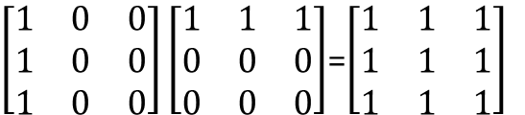

Sparse Matrices
2.5.3 Matrix multiplication
Definition:
Given A and B where A is m×n and B is n×p, the product matrix D has dimension m×p. Its <i, j> element is
$d_{ij}=\sum_{k=0}^{n−1}{a_{ik}b_{kj}},for 0≤i<m$, $0≤j<p$
$\left[\begin{matrix}1 & 0 & 0 \\ 1 & 0 & 0 \\ 1 & 0 & 0\end{matrix}\right]\left[\begin{matrix}1 & 1 & 1 \\ 0 & 0 & 0 \\ 0 & 0 & 0\end{matrix}\right]$=$\left[\begin{matrix}1 & 1 & 1 \\ 1 & 1 & 1 \\ 1 & 1 & 1\end{matrix}\right]$

Slide 58
Sparse Matrices
Sparse Matrix Multiplication
Definition: [D]_{m*p}=[A]_{m*n}* [B]_{n*p}
Procedure: Fix a row of A and find all elements in column j of B for j=0, 1, …, p-1.
Alternative 1. Scan all of B to find all elements in j.
Alternative 2. Compute the transpose of B. (Put all column elements consecutively)
Once we have located the elements of row i of A and column j of B we just do a merge operation similar to that used in the polynomial addition of 2.2

Slide 59
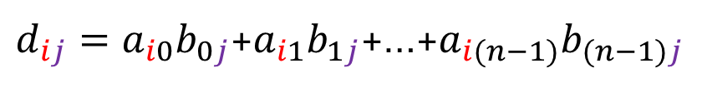
Sparse Matrices
$d_{ij}=a_{i0}b_{0j}$+$a_{i1}b_{1j}$+…+$a_{i(n−1)}b_{(n−1)j}$
General case:
d_{ij}=a_{i0}*b_{0j}+a_{i1}*b_{1j}+…+a_{i(n-1)}*b_{(n-1)j}
Array A is grouped by i, and after transpose, array B is also grouped by j
A以i分群、B以j分群(B需要轉置)
a a_{0*} d b_{*0}
b a_{1*} e b_{*1}
c a_{2*} f b_{*2}
g b_{*3}
The multiply operation generate entries:
a*d , a*e , a*f , a*g , b*d , b*e , b*f , b*g , c*d , c*e , c*f , c*g

Slide 60
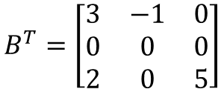

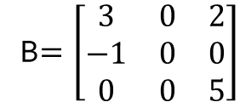
Sparse Matrices
$$A=\left[\begin{matrix}1 & 0 & 2 \\ −1 & 4 & 6\end{matrix}\right]$$
$$B^{T}=\left[\begin{matrix}3 & −1 & 0 \\ 0 & 0 & 0 \\ 2 & 0 & 5\end{matrix}\right]$$
B$=\left[\begin{matrix}3 & 0 & 2 \\ −1 & 0 & 0 \\ 0 & 0 & 5\end{matrix}\right]$
row
col
value
row
col
value
row
col
value
a[0] 2 3 5 b_{t}[0] 3 3 4 b[0] 3 3 4
[1] 0 0 1 b_{t}[1] 0 0 3 b[1] 0 0 3
[2] 0 2 2 b_{t}[2] 0 1 -1 b[2] 0 2 2
[3] 1 0 -1 b_{t}[3] 2 0 2 b[3] 1 0 -1
[4] 1 1 4 b_{t}[4] 2 2 5 b[4] 2 2 5
[5] 1 2 6
d₀₀
d₀₂
d₁₀
d₁₂

Slide 61
a[0] 2 3 5 b_{t}[0] 3 3 4 b[0] 3 3 4
[1] 0 0 1 b_{t}[1] 0 0 3 b[1] 0 0 3
[2] 0 2 2 b_{t}[2] 0 1 -1 b[2] 0 2 2
[3] 1 0 -1 b_{t}[3] 2 0 2 b[3] 1 0 -1
[4] 1 1 4 b_{t}[4] 2 2 5 b[4] 2 2 5
[5] 1 2 6
row
col
value
row
col
value
row
col
value
[5] 3 0
[6] 2
void mmult (term a[ ], term b[ ], term d[ ] )
/* multiply two sparse matrices */
{
int i, j, column, totalB = b[].value, totalD = 0;
int rowsA = a[0].row, colsA = a[0].col,totalA = a[0].value;
int colsB = b[0].col;
int rowBegin = 1, row = a[1].row, sum =0;
int newB[MAX_TERMS][3];
if (colsA != b[0].row){
fprintf (stderr, "Incompatible matrices\n");
exit (EXIT_FAIFURE);
}
fastTranspose(b, newB);
/* set boundary condition */
a[totalA+1].row = rowsA;
newB[totalB+1].row = colsB;
newB[totalB+1].col = 0;
totalA = 5
totalB = 4
totalD = 0
rowsA = 2
colsA = 3
colsB = 3
O(colsB+ totalB)
row: 目前在A的第幾列
rowBegin: 目前A處理列的第一個元素位置
column: 目前在B的第幾行
totalD: D矩陣元素個數
newB: B的轉置矩陣
rowBegin = 1
row = 0

Slide 62
totalA = 5
rowsA = 2
rowBegin = 1
Variable
Value
D
totalB = 4
colsA = 3
row = 0
3
1
2
i
1
1
3
2
colsB = 3
2
totalD = 0
7
d[1] 0 0 3
5
1
2
j
6
3
4
for (i = 1; i <= totalA; ) {
column = newB[1].row;
for (j = 1; j <= totalB+1;) {
/* mutiply row of a by column of b */
if (a[i].row != row) {
storeSum(d, &totalD, row, column, &sum);
i = rowBegin;
for (; newB[j].row == column; j++)
;
column =newB[j].row;
}
else if (newB[j].row !=column)
{
storeSum(d,&totalD, row, column, &sum);
i = rowBegin;
column =newB[j].row;
}
else switch (COMPARE (a[i].col, newB[j].col)) {
case -1: /* go to next term in a */
i++; break;
case 0: /* add terms, go to next term in a and b */
sum += (a[i++].value * newB[j++].value);
break;
case 1: /* advance to next term in b*/
j++;
}
} /* end of for j <= totalB+1 */
for (; a[i].row == row; i++)
;
rowBegin = i; row = a[i].row;
} /* end of for i <=totalA */
d[0].row = rowsA;
d[0].col = colsB; d[0].value = totalD;
}
0
d[2] 0 2 12
column
3
2
row
1
0
sum
12
3
0
2
0
rowBegin
1
第column行的元素都做完,
j 指到下一個column的元素位置
3
a[0] 2 3 5
[1] 0 0 1
[2] 0 2 2
[3] 1 0 -1
[4] 1 1 4
[5] 1 2 6
[6] 2
A[0][0]*B[0][0]
A[0][0]*B[0][2]
A[0][2]*B[2][2]
row: 目前在A的第幾列
rowBegin: 目前A處理列的
第一個元素位置
column: 目前在B的第幾行
totalD: D矩陣元素個數
newB: B的轉置矩陣
i: 紀錄A元素
j: 紀錄B元素
b_{t}[0] 3 3 4
b_{t}[1] 0 0 3
b_{t}[2] 0 1 -1
b_{t}[3] 2 0 2
b_{t}[4] 2 2 5
b_{t}[5] 3 0
第row列的元素都做完,
i 指到下一個row的元素位置
And So on…

Slide 63
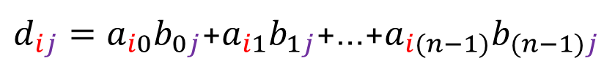
Sparse Matrices
void storeSum(term d[ ], int *totalD, int row, int column, int *sum)
{/* if *sum != 0, then it along with its row and column
position is stored as the *totalD+1 entry in d */
if (*sum)
if (*totalD < MAX_TERMS) {
d[++*totalD].row = row;
d[*totalD].col = column;
d[*totalD].value = *sum;
}
else {
fprintf(stderr, "Numbers of terms in product exceed %d\n", MAX_TERMS);
exit(EXIT_FAILURE);
}
}
儲存d的第row列第column為sum
$d_{ij}=a_{i0}b_{0j}$+$a_{i1}b_{1j}$+…+$a_{i(n−1)}b_{(n−1)j}$

Slide 64
Sparse Matrices
Analyzing the algorithm
colsB * termsRow1 + totalB + colsB * termsRow2 + totalB + … + colsB * termsRowp + totalB = colsB * (termsrow1 + termsrow2 + … + termsrowp)+ rowsA * totalB = colsB * totalaA+ rowsA * totalB O(colsB * totalA + rowsA * totalB)
B的每一行要跟A的每一列的個數元素(termsRow)相乘
判斷下一行的元素位置至多執行totalB次
for (; newB[j].row == column; j++)
a[0] 2 3 5 b_{t}[0] 3 3 4 b[0] 3 3 4
[1] 0 0 1 b_{t}[1] 0 0 3 b[1] 0 0 3
[2] 0 2 2 b_{t}[2] 0 1 -1 b[2] 0 2 2
[3] 1 0 -1 b_{t}[3] 2 0 2 b[3] 1 0 -1
[4] 1 1 4 b_{t}[4] 2 2 5 b[4] 2 2 5
[5] 1 2 6

Slide 65
Sparse Matrices
Compared with matrix multiplication using array
for (i =0; i < rowsA; i++) for (j=0; j < colsB; j++) { sum =0; for (k=0; k < colsA; k++) sum += (a[i][k] *b[k][j]); d[i][j] =sum; }
O(rowsA * colsA * colsB) vs. O(colsB * totalA + rowsA * totalB)
optimal case: totalA < rowsA * colsA
totalB < colsA * colsB
worse case: totalA --> rowsA * colsA, or totalB --> colsA * colsB
colsA = rowsB
colsA = rowsB

Slide 66
Representation of multidimensional array

Slide 67
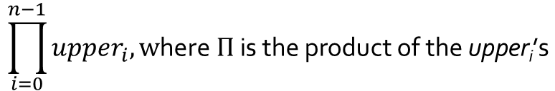
Representation of multidimensional array
The internal representation of multidimensional arrays requires more complex addressing formula.
If an array is declared a[upper₀][upper₁]…[upper_{n}], then it is easy to see that the number of elements in the array is:
Example:
If we declare a as a[10][10][10], then we require 10*10*10 = 1000 units of storage to hold the array
$$\prod_{i=0}^{n−1}{{upper}_{i},\text{w}\text{here} Π \text{is} \text{the} \text{product} \text{of} \text{the} \text{upper}\text{i}\text{’}\text{s}}$$

Slide 68
Representation of multidimensional array
3-dimension
3-dimension Array: A_{x,y,z}
Each item space: d
Initial address: L₀ => address(A[0,0,0]) = L₀
Row major (z -> y -> x)
as x two-dimensional arrays of dimension y×z
address(A[0,0,1]) = L₀ + d
address(A[0,0,2]) = L₀ + 2d
…
address(A[0,0,z-1]) = L₀ + (z-1)d
address(A[0,1,0]) = L₀ + zd
…
address(A[0,1,z-1]) = L₀ + zd +(z-1)d
…
address(A[0,y-1,z-1]) = L₀ + (y-1)zd +(z-1)d
address(A[1,0,0]) = L₀ + (y-1)zd +(z-1)d+d = L₀ + yzd
address(A[i,j,k]) = L₀ + iyzd +jzd+kd
address(A[x-1,y-1,z-1]) = L₀ + (x-1)yzd +(y-1)zd+(z-1)d

Slide 69

Representation of multidimensional array
Row major
3-dimension Array: A_{x,y,z}
Each item space: d
A(x₁:x₂, y₁:y₂ , z₁:z₂)
Initial address: L₀ => address(A[x₁, y₁, z₁]) = L₀
$A\left[i,j,k\right]=L_{o}+\left(i−x_{1}\right)yzd+\left(j−y_{1}\right)zd+\left(k−z_{1}\right)d$

Slide 70
Representation of multidimensional array
3-dimension
3-dimension Array: A_{x,y,z}
Each item space: d
Initial address: L₀ => address(A[0,0,0]) = L₀
Column major (x -> y -> z)
address(A[1,0,0]) = L₀ + d
address(A[2,0,0]) = L₀ + 2d
…
address(A[x-1,0,0]) = L₀ + (x-1)d
address(A[0,1,0]) = L₀ + xd
…
address(A[x-1,1,0]) = L₀ + xd +(x-1)d
…
address(A[x-1,y-1,0]) = L₀ + (y-1)xd +(x-1)d
address(A[0,0,1]) = L₀ + (y-1)xd +(x-1)d+d = L₀ + xyd
address(A[i,j,k]) = L₀ + kxyd +jxd+id
address(A[x-1,y-1,z-1]) = L₀ + (z-1)xyd +(y-1)xd+(x-1)d

Slide 71

Representation of multidimensional array
Column major
3-dimension Array: A_{x,y,z}
Each item space: d
A(x₁:x₂, y₁:y₂ , z₁:z₂)
Initial address: L₀ => address(A[x₁, y₁, z₁]) = L₀
$A\left[i,j,k\right]=L_{o}+\left(k−z_{1}\right)xyd+\left(j−y_{1}\right)xd+\left(i−x_{1}\right)d$

Slide 72
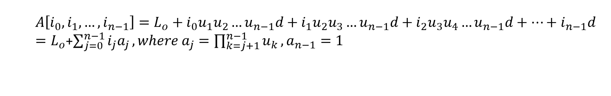
Representation of multidimensional array
N- dimension
A[u₀, u₁…, u_{n-1}] is an n-dimensional array
Row major
The address for A[i₀, i₁, … ,i_{n-1}] is:
$$A\left[i_{0},i_{1},…,i_{n−1}\right]=L_{o}+i_{0}u_{1}u_{2}…u_{n−1}d+i_{1}u_{2}u_{3}…u_{n−1}d+i_{2}u_{3}u_{4}…u_{n−1}d+…+i_{n−1}d$$
$=L_{o}$+$\sum_{j=0}^{n−1}{i_{j}a_{j}},where a_{j}=\prod_{k=j+1}^{n−1}{u_{k}}, a_{n−1}=1$

Slide 73
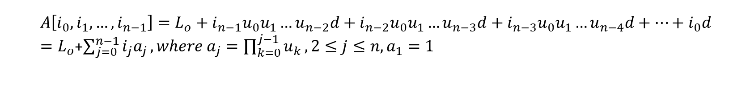
Representation of multidimensional array
N- dimension
A[u₀, u₁…, u_{n-1}] is an n-dimensional array
Column major
The address for A[i₀, i₁, … ,i_{n-1}] is:
$$A\left[i_{0},i_{1},…,i_{n−1}\right]=L_{o}+i_{n−1}u_{0}u_{1}…u_{n−2}d+i_{n−2}u_{0}u_{1}…u_{n−3}d+i_{n−3}u_{0}u_{1}…u_{n−4}d+…+i_{0}d$$
$=L_{o}$+$\sum_{j=0}^{n−1}{i_{j}a_{j}},where a_{j}=\prod_{k=0}^{j−1}{u_{k}},2≤j≤n,a_{1}=1$

Slide 74
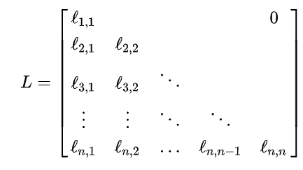
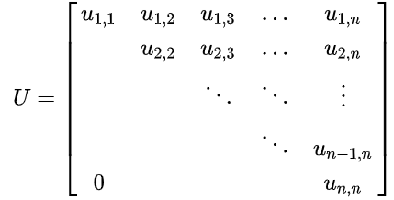

Special Matrix
Lower triangular matrix (left triangular matrix)
Upper triangular matrix or right triangular matrix
$$\#nonzero terms=\frac{n(n+1)}{2}$$
https://en.wikipedia.org/wiki/Triangular_matrix

Slide 75
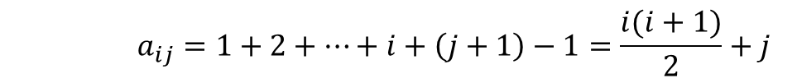

Special Matrix
a_{oo}=0
a_{1o}=1
a₁₁=2
a_{2o}=3
…
1-dimension Array: B_{m}, $m=\frac{n(n+1)}{2}$
a[0,0] being stored in b[0]
Row major
Lower triangular matrix
$a_{ij}=\frac{i(i+1)}{2}+j=k$
Upper triangular matrix
$a_{ij}=ni−\frac{i\left(i+1\right)}{2}+j=k$
Column major
Lower triangular matrix
$a_{ij}=nj−\frac{j\left(j+1\right)}{2}+i=k$
Upper triangular matrix
$a_{ij}=\frac{j(j+1)}{2}+i=k$
0
0
1 | 2
3 | 4 | 5
6 | 7 | 8 | 9
1
2
3
…
i
…
0
1
2
3
j
第i列第j個
$$a_{ij}=1+2+…+i+\left(j+1\right)−1=\frac{i(i+1)}{2}+j$$
前i-1列個數
從0開始

Slide 76
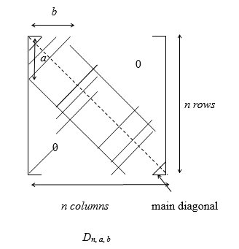
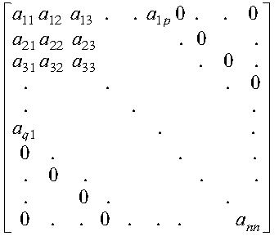

Special Matrix
Band Matrix
$a_{ij}=0, if j≤i−a or j≥i+b$
p
q
https://www.ibm.com/support/knowledgecenter/SSFHY8_6.1/reference/am5gr_bandma.html

Slide 77
Q&A

